Slide 1
Oxygen and the Salas y Gómez Ridge
Kara Eckley

Slide 2
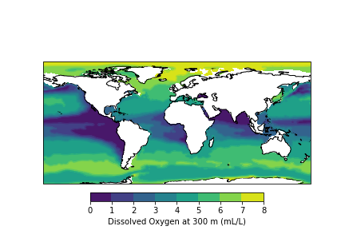
Background
Salas y Gómez Ridge (SyG)
Extends ~2,900 km from the Desventuradas Islands to beyond Easter Island
Dozens of seamounts
High levels of endemism
Eastern South Pacific Oxygen Minimum Zone
East/Central Pacific International Campaign (EPIC) Cruise 2019
Surveyed SyG seamounts and oceanic islands
Towed camera
Environmental data: dissolved oxygen, temperature, salinity
CSIRO CARS 2009 Oxygen Data
Notes:
Extends ~2,900 km from the Desventuradas Islands to beyond Easter Island
Created by a hotspot, oldest formations in the east end of the ridge, 23 million years old, to 2 mya on the west end
The hotspot is currently thought to be between Easter Island and Salas y Gomez Island
Range of unique conditions
Oxygen minimum zone – some organisms are adapted to this, others can’t live in it, and below it there may be an abundance of life where oxygen is normal and food fall is plentiful
South Pacific Subtropical Gyre – highly oligotrophic, not much plankton, water is clear and light can penetrate deeply
High level of endemic species

Slide 3
Methods
One seamount: SPG6; One island: SPG7
3 files per site: Habitat analysis, CTD data, and latitude and longitude
Datetime indices to combine
Cartopy
Map transects
Plot oxygen minimum zone with CARS 2009 data
Matplotlib
Depth profiles: temperature, salinity, dissolved oxygen
Scipy Stats
Linear regression on oxygen varying by depth
Notes:
Extends ~2,900 km from the Desventuradas Islands to beyond Easter Island
Created by a hotspot, oldest formations in the east end of the ridge, 23 million years old, to 2 mya on the west end
The hotspot is currently thought to be between Easter Island and Salas y Gomez Island
Range of unique conditions
Oxygen minimum zone – some organisms are adapted to this, others can’t live in it, and below it there may be an abundance of life where oxygen is normal and food fall is plentiful
South Pacific Subtropical Gyre – highly oligotrophic, not much plankton, water is clear and light can penetrate deeply
High level of endemic species

Slide 4
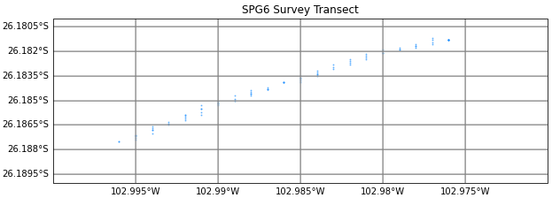
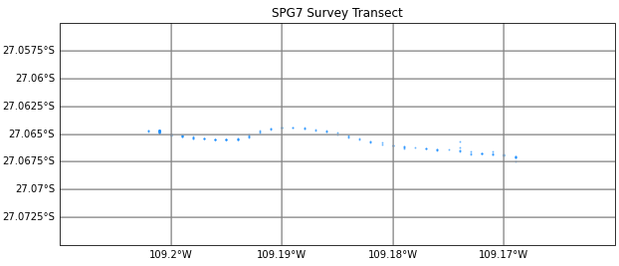
Notes:
Data Analyses
Hypotheses
Higher abundance and diversity at seamounts compared to oceanic islands.
Community composition will vary with substrate type, depth, and oxygen.
Analyses
Geographic analysis using ArcGIS
Species accumulation curve, assess the level of sampling
Diversity indices and richness - unpaired two-sample Wilcoxon test
Past analyses
CCA: (canonical correlation analysis) to analyze the relationship between the community/species assemblage and the environmental conditions.
PERMANOVA: non-parametric, (permutational multivariate analysis of variance), can look at the environmental variables.
Hierarchical clustering analyses

Slide 5
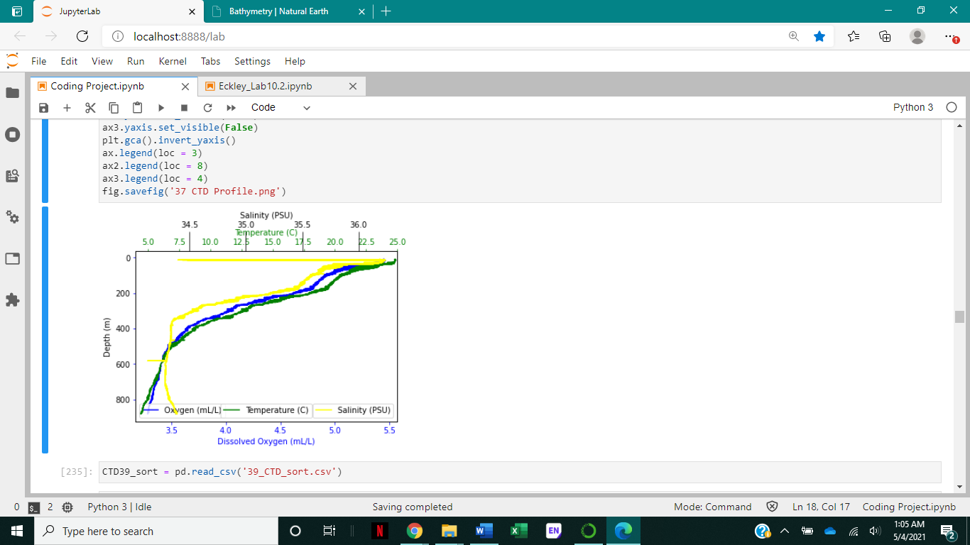
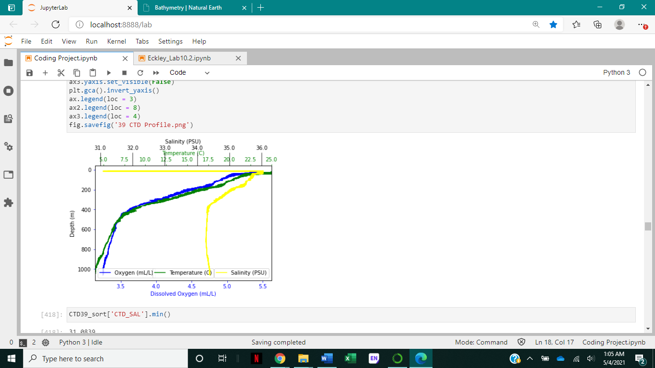
Depth profile for SPG6
Depth profile for SPG7
Notes:
Data Analyses
Hypotheses
Higher abundance and diversity at seamounts compared to oceanic islands.
Community composition will vary with substrate type, depth, and oxygen.
Analyses
Geographic analysis using ArcGIS
Species accumulation curve, assess the level of sampling
Diversity indices and richness - unpaired two-sample Wilcoxon test
Past analyses
CCA: (canonical correlation analysis) to analyze the relationship between the community/species assemblage and the environmental conditions.
PERMANOVA: non-parametric, (permutational multivariate analysis of variance), can look at the environmental variables.
Hierarchical clustering analyses

Slide 6
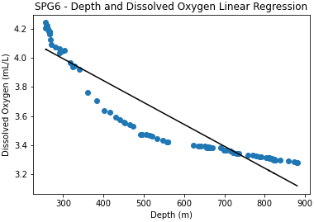
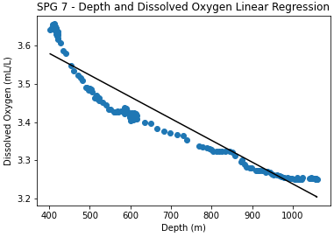
p = 7.58 x 10⁸, r = -0.93
p = 4.84 x 10⁷⁴, r = -0.95
Notes:
Data Analyses
Hypotheses
Higher abundance and diversity at seamounts compared to oceanic islands.
Community composition will vary with substrate type, depth, and oxygen.
Analyses
Geographic analysis using ArcGIS
Species accumulation curve, assess the level of sampling
Diversity indices and richness - unpaired two-sample Wilcoxon test
Past analyses
CCA: (canonical correlation analysis) to analyze the relationship between the community/species assemblage and the environmental conditions.
PERMANOVA: non-parametric, (permutational multivariate analysis of variance), can look at the environmental variables.
Hierarchical clustering analyses

Slide 7
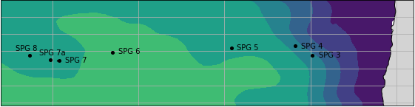
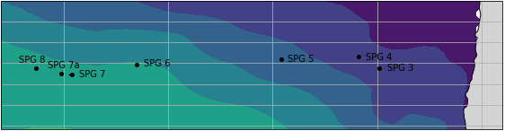
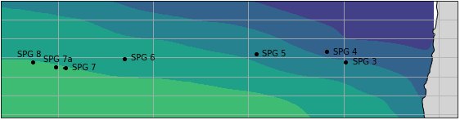
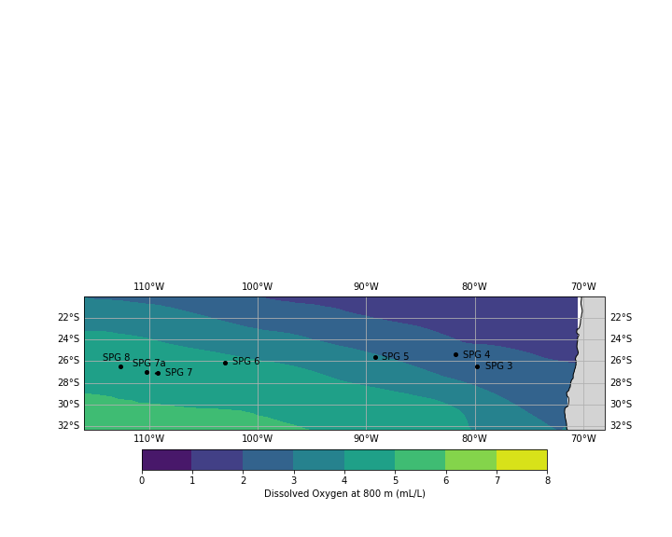
110°W
100°W
90°W
80°W
22°S
200 m
24°S
26°S
28°S
30°S
32°S
22°S
400 m
24°S
26°S
28°S
30°S
32°S
22°S
600 m
24°S
26°S
28°S
30°S
32°S
22°S
800 m
24°S
26°S
28°S
30°S
32°S
Notes:
Data Analyses
Hypotheses
Higher abundance and diversity at seamounts compared to oceanic islands.
Community composition will vary with substrate type, depth, and oxygen.
Analyses
Geographic analysis using ArcGIS
Species accumulation curve, assess the level of sampling
Diversity indices and richness - unpaired two-sample Wilcoxon test
Past analyses
CCA: (canonical correlation analysis) to analyze the relationship between the community/species assemblage and the environmental conditions.
PERMANOVA: non-parametric, (permutational multivariate analysis of variance), can look at the environmental variables.
Hierarchical clustering analyses

Slide 8
Notes:
Data Analyses
Hypotheses
Higher abundance and diversity at seamounts compared to oceanic islands.
Community composition will vary with substrate type, depth, and oxygen.
Analyses
Geographic analysis using ArcGIS
Species accumulation curve, assess the level of sampling
Diversity indices and richness - unpaired two-sample Wilcoxon test
Past analyses
CCA: (canonical correlation analysis) to analyze the relationship between the community/species assemblage and the environmental conditions.
PERMANOVA: non-parametric, (permutational multivariate analysis of variance), can look at the environmental variables.
Hierarchical clustering analyses

Slide 9
Conclusions
Oxygen varied by depth
Non-linear regression probably would have been more appropriate
Oxygen did not appear to vary by site
Analysis of additional sites may affect this
Future work
Adding the five additional sites
Mapping EPIC bathymetric data
Combining habitat analysis with environmental data
Notes:
Extends ~2,900 km from the Desventuradas Islands to beyond Easter Island
Created by a hotspot, oldest formations in the east end of the ridge, 23 million years old, to 2 mya on the west end
The hotspot is currently thought to be between Easter Island and Salas y Gomez Island
Range of unique conditions
Oxygen minimum zone – some organisms are adapted to this, others can’t live in it, and below it there may be an abundance of life where oxygen is normal and food fall is plentiful
South Pacific Subtropical Gyre – highly oligotrophic, not much plankton, water is clear and light can penetrate deeply
High level of endemic species

Slide 10
Questions?

